Slide 1
Report 11/13/2020
P. Hacker

Slide 2
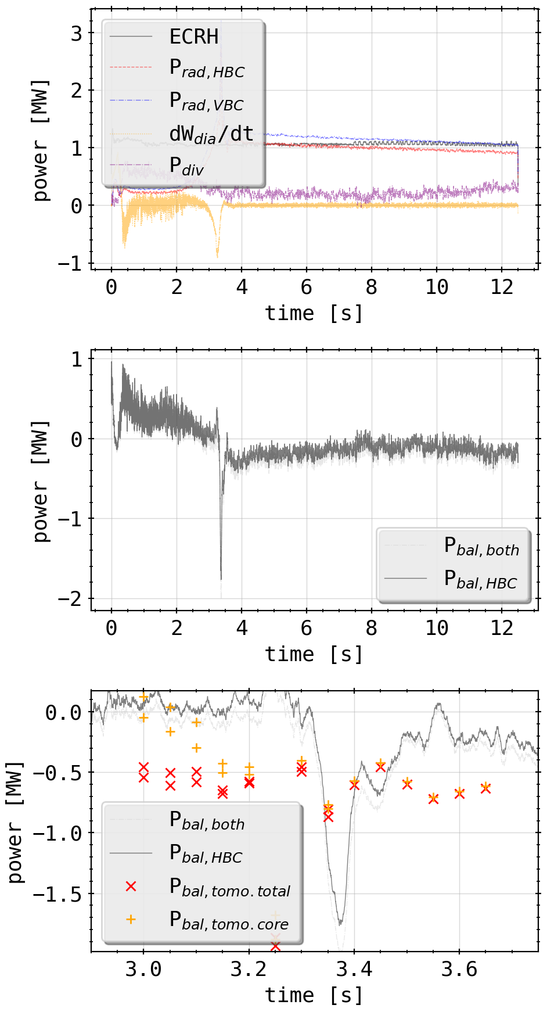
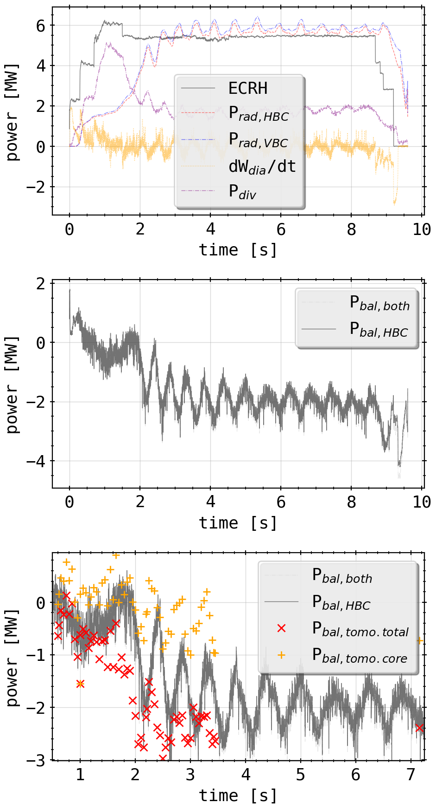
Tomogram Statistics: Experiment Power Balance
compiled experiment data and parameters to calculate
also exchanged radiated power proxy from bolometer camera by 2D integrated power of tomogram (both core and total)
20180725.044
20181010.032

Slide 3
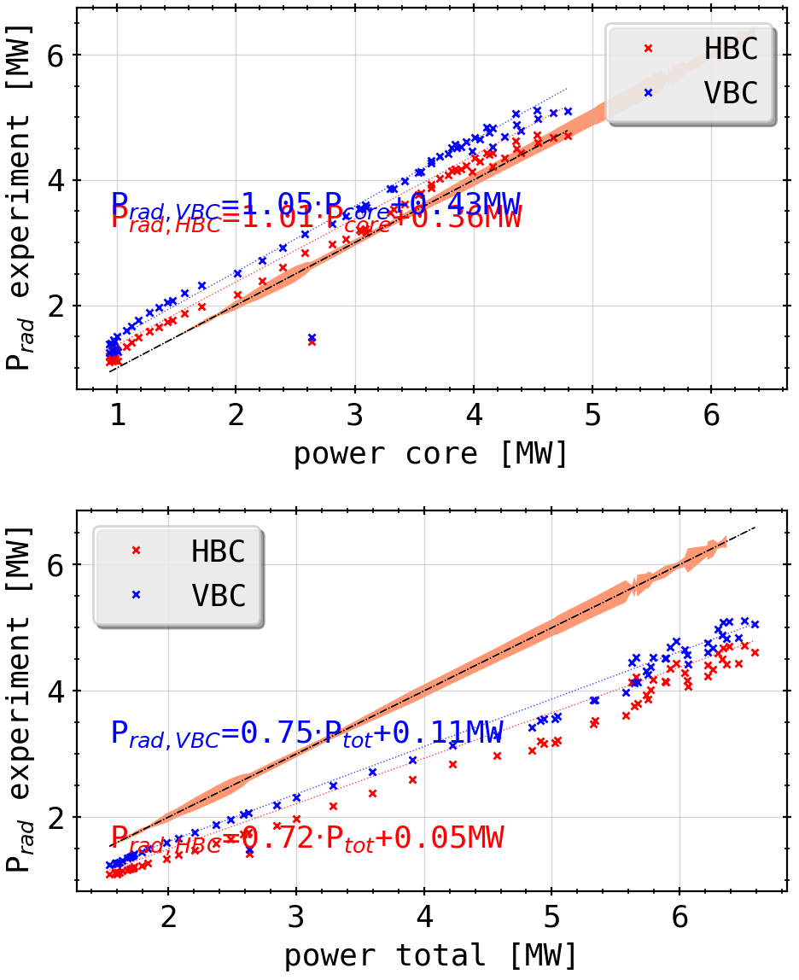
Tomogram Statistics: Experiment Reconstructions Errorbar
20181010.032
extra slope in P_rad vs. total power by cutting negative results from reconstruction when limiting to only physically meaningful numbers (P/m³>0)?
increase of their impact is expected with overall higher radiation level to counteract errors in chordal profile
impact of mathematical error is negligible across the power spectrum, but why?
fit of integrated power values vs camera proxy yields interesting results (~0.4MW offset to core power, ~0.75 ratio to total 2D power)
CONCLUSION

Slide 4
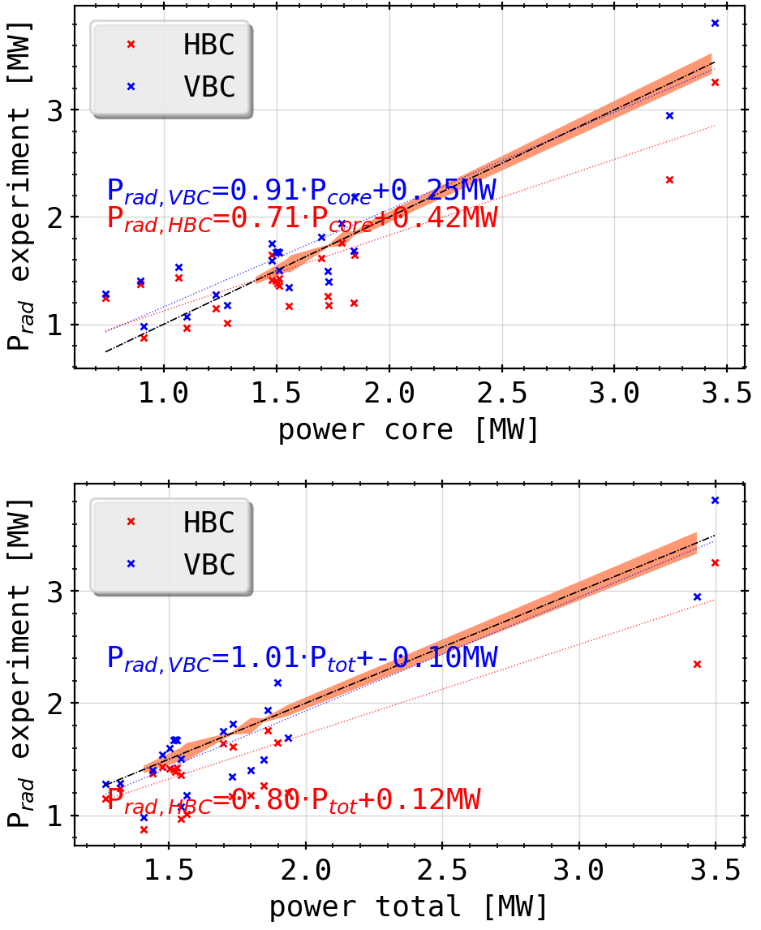
Tomogram Statistics: Experiment Reconstructions Errorbar
20180725.044
extra slope in P_rad vs. total power by cutting negative results from reconstruction when limiting to only physically meaningful numbers (P/m³>0)?
increase of their impact is expected with overall higher radiation level to counteract errors in chordal profile
impact of mathematical error is negligible across the power spectrum, but why?
fit of integrated power values vs camera proxy yields interesting results (~0.4MW offset to core power, ~0.7 ratio to total 2D power)
changes for different discharge types?
CONCLUSION

Slide 5
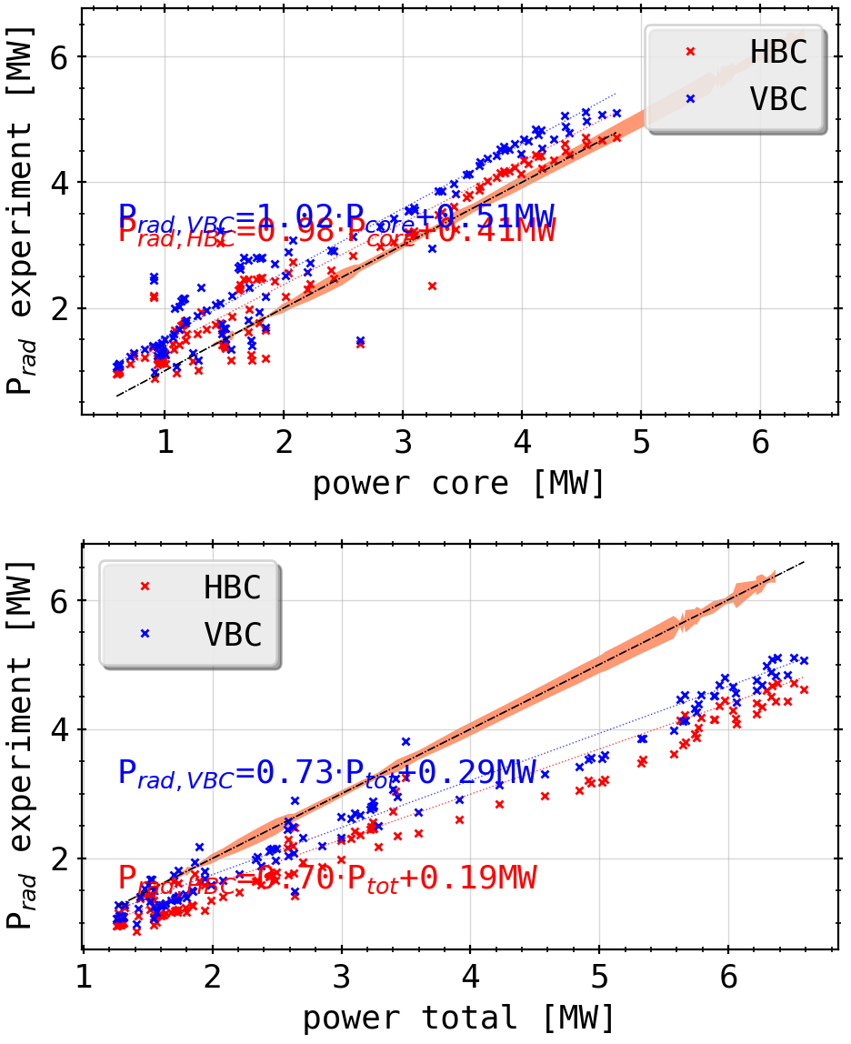
Tomogram Statistics: Experiment Reconstructions Errorbar
(combined)
extra slope in P_rad vs. total power by cutting negative results from reconstruction when limiting to only physically meaningful numbers (P/m³>0)?
increase of their impact is expected with overall higher radiation level to counteract errors in chordal profile
impact of mathematical error is negligible across the power spectrum, but why?
fit of integrated power values vs camera proxy yields interesting results (~0.4MW offset to core power, ~0.7 ratio to total 2D power)
changes for different discharge types?
CONCLUSION

Slide 6
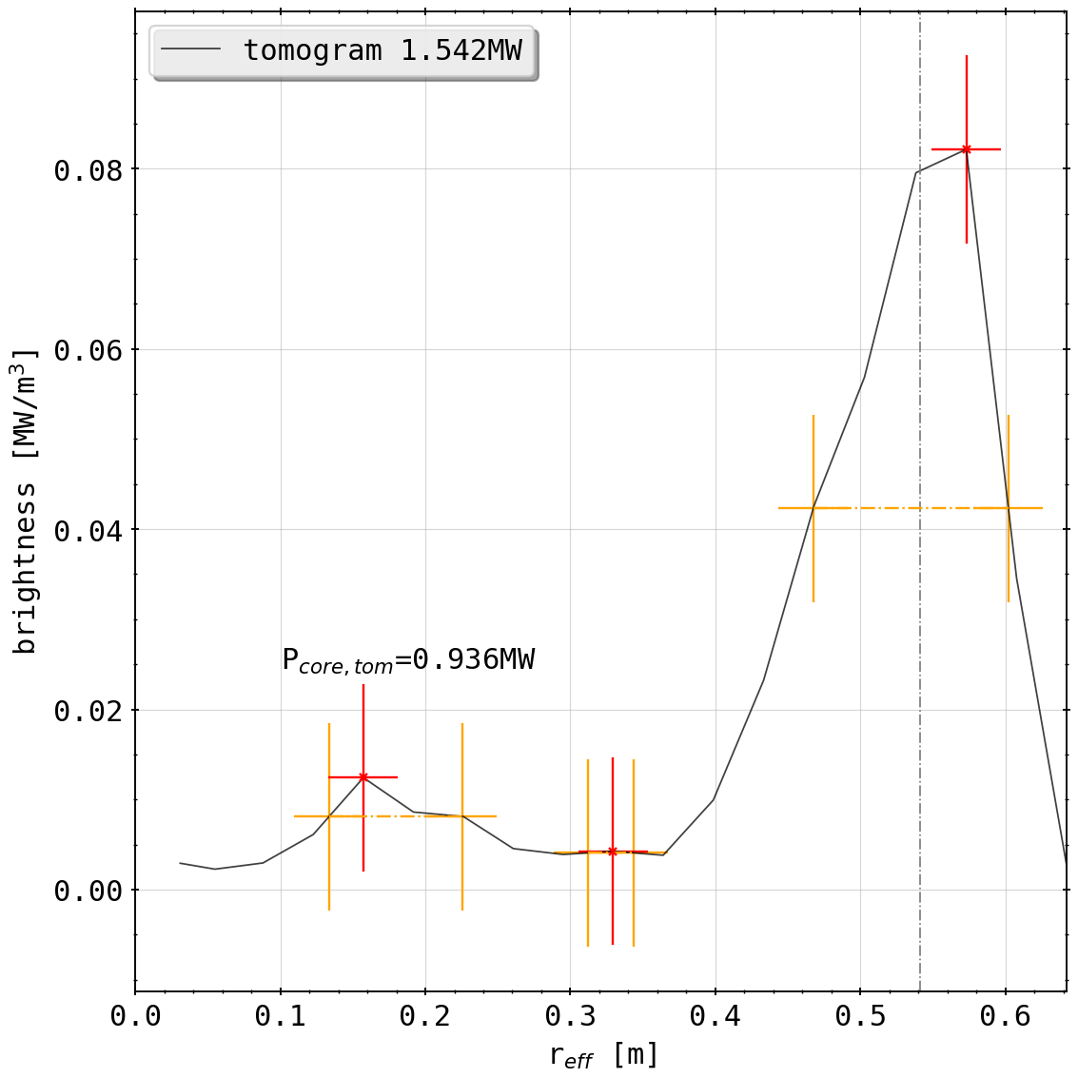
Tomogram Statistics: Experiment Reconstructions Errorbar
20180725.044@3.45s
errorbar looks large here, because the total error for the tomogram (minimum value < 0.0 can be single cell or whole ‘ring’) has to assumed possible at every integration point
e.g.: at powers (both X²~1.0)
total: 5.78 MW , neg: 66.63 kW
total: 6.33 MW, neg: 61.68 kW
total: 2.37 MW, neg: 121.51 kW

Slide 7
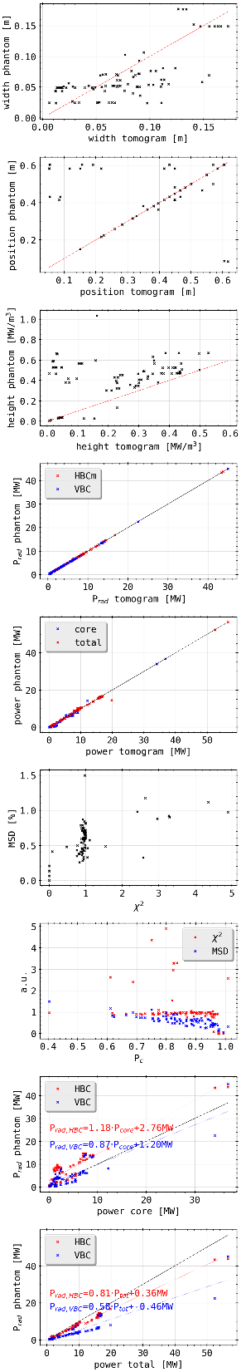
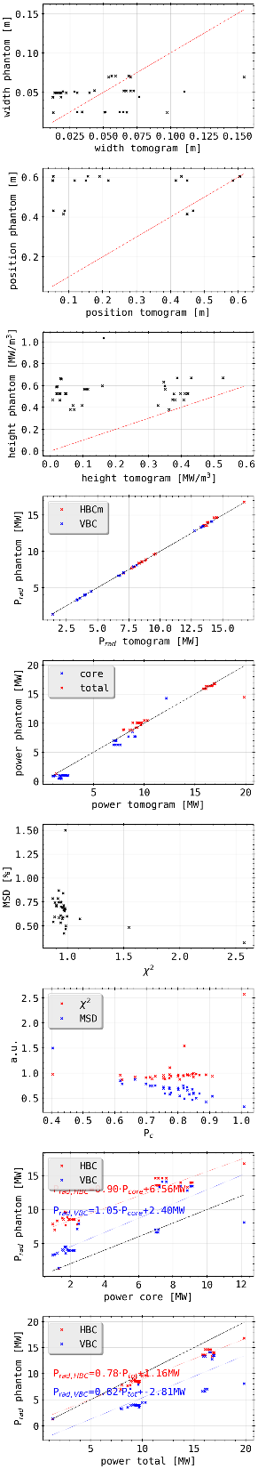
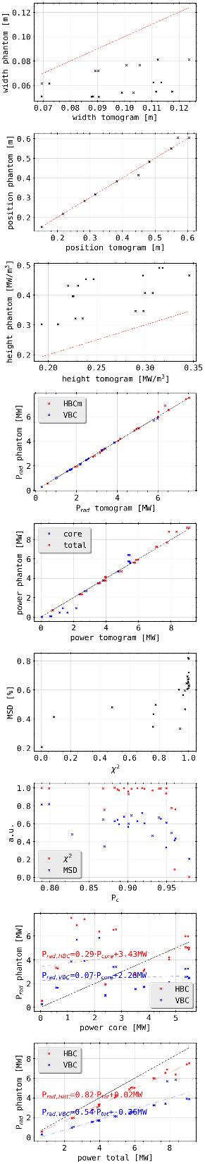
Tomogram Statistics: Phantom Reconstructions
(all phantoms)
(island mimics)
(radiation ring)

Slide 8
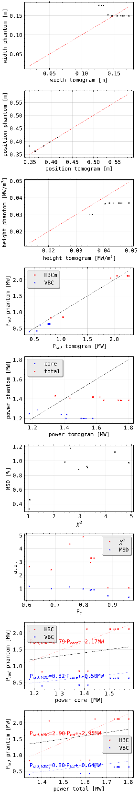
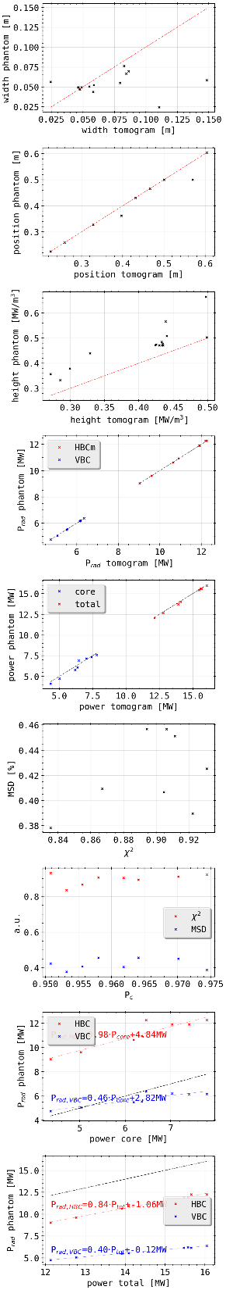
Tomogram Statistics: Phantom Reconstructions
(all phantoms)
(radiation spot)
(double ring)

Slide 9
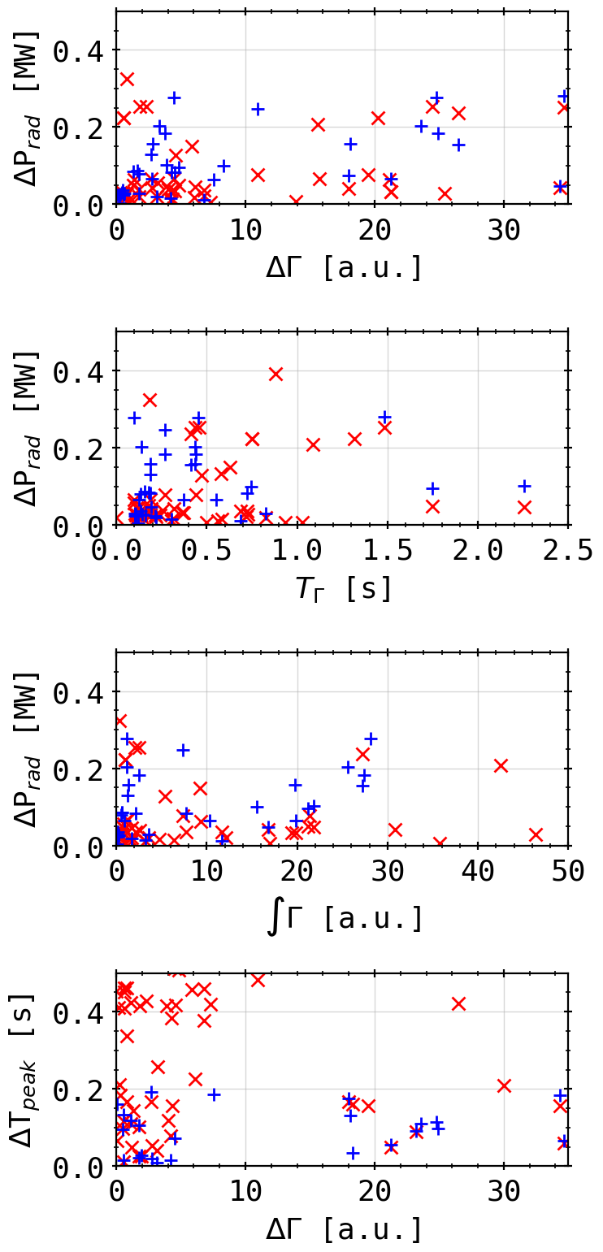
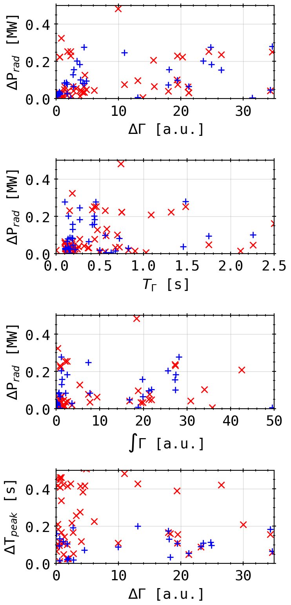
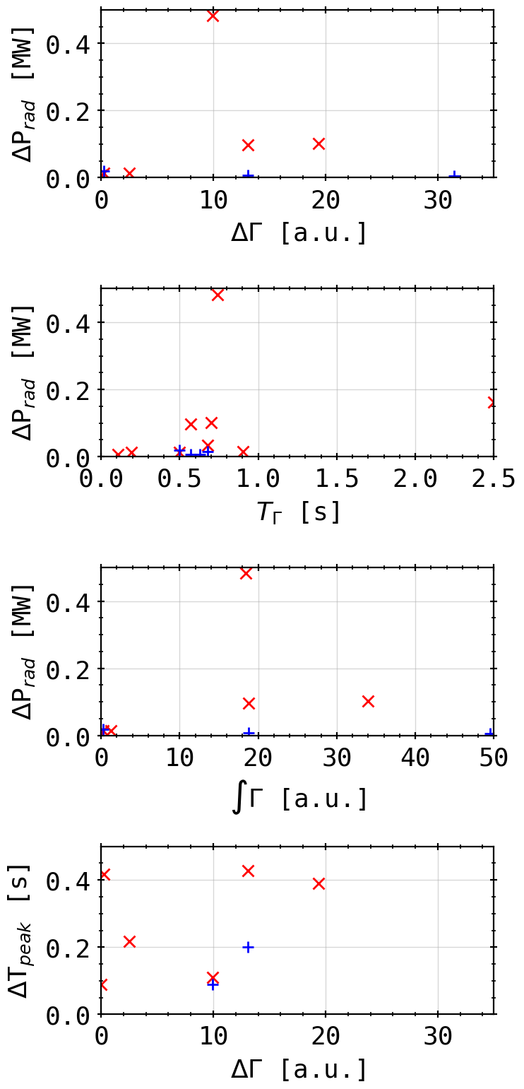
Peak Statistic: Methane Session with QSQ
HBC
VBC
H2
He
CH4
100 ms

Slide 10

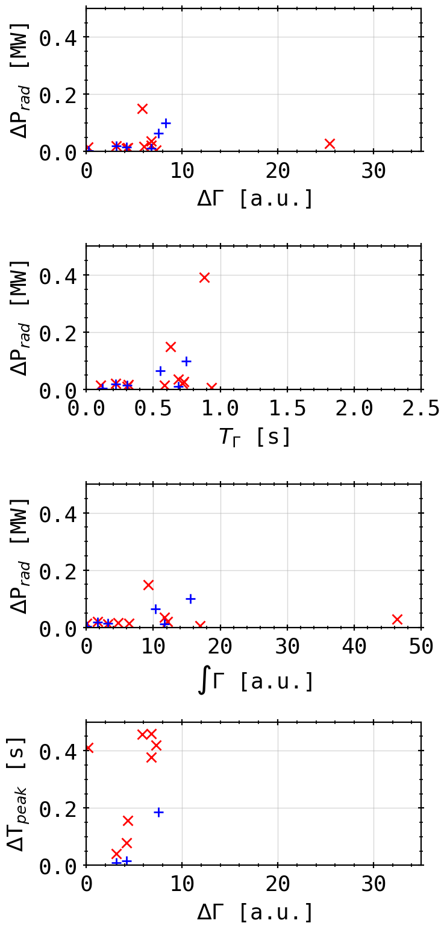
Peak Statistic: Methane Session with QSQ
HBC
VBC
Main Valve
QSQ
100 ms

